Slide 1
Optimal Barley Crush Locations
Utilizing Clustering Crop Yield Analysis - RM Level

Slide 2


Data
RM Barley Yield
GIS Data

Slide 3
EDA (Exploratory Data Analysis)

Slide 4
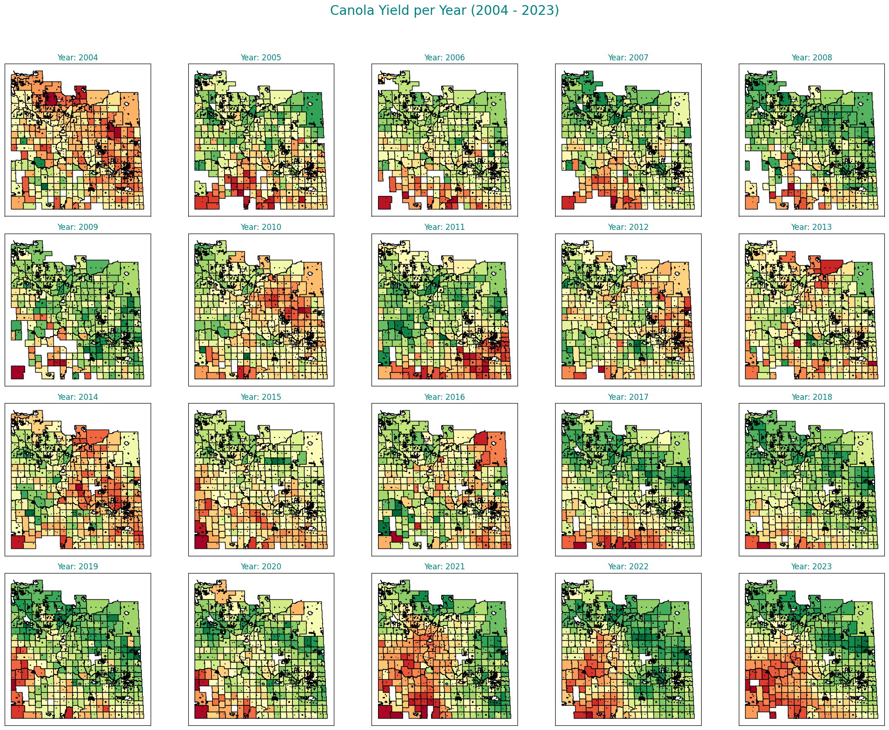

Slide 5
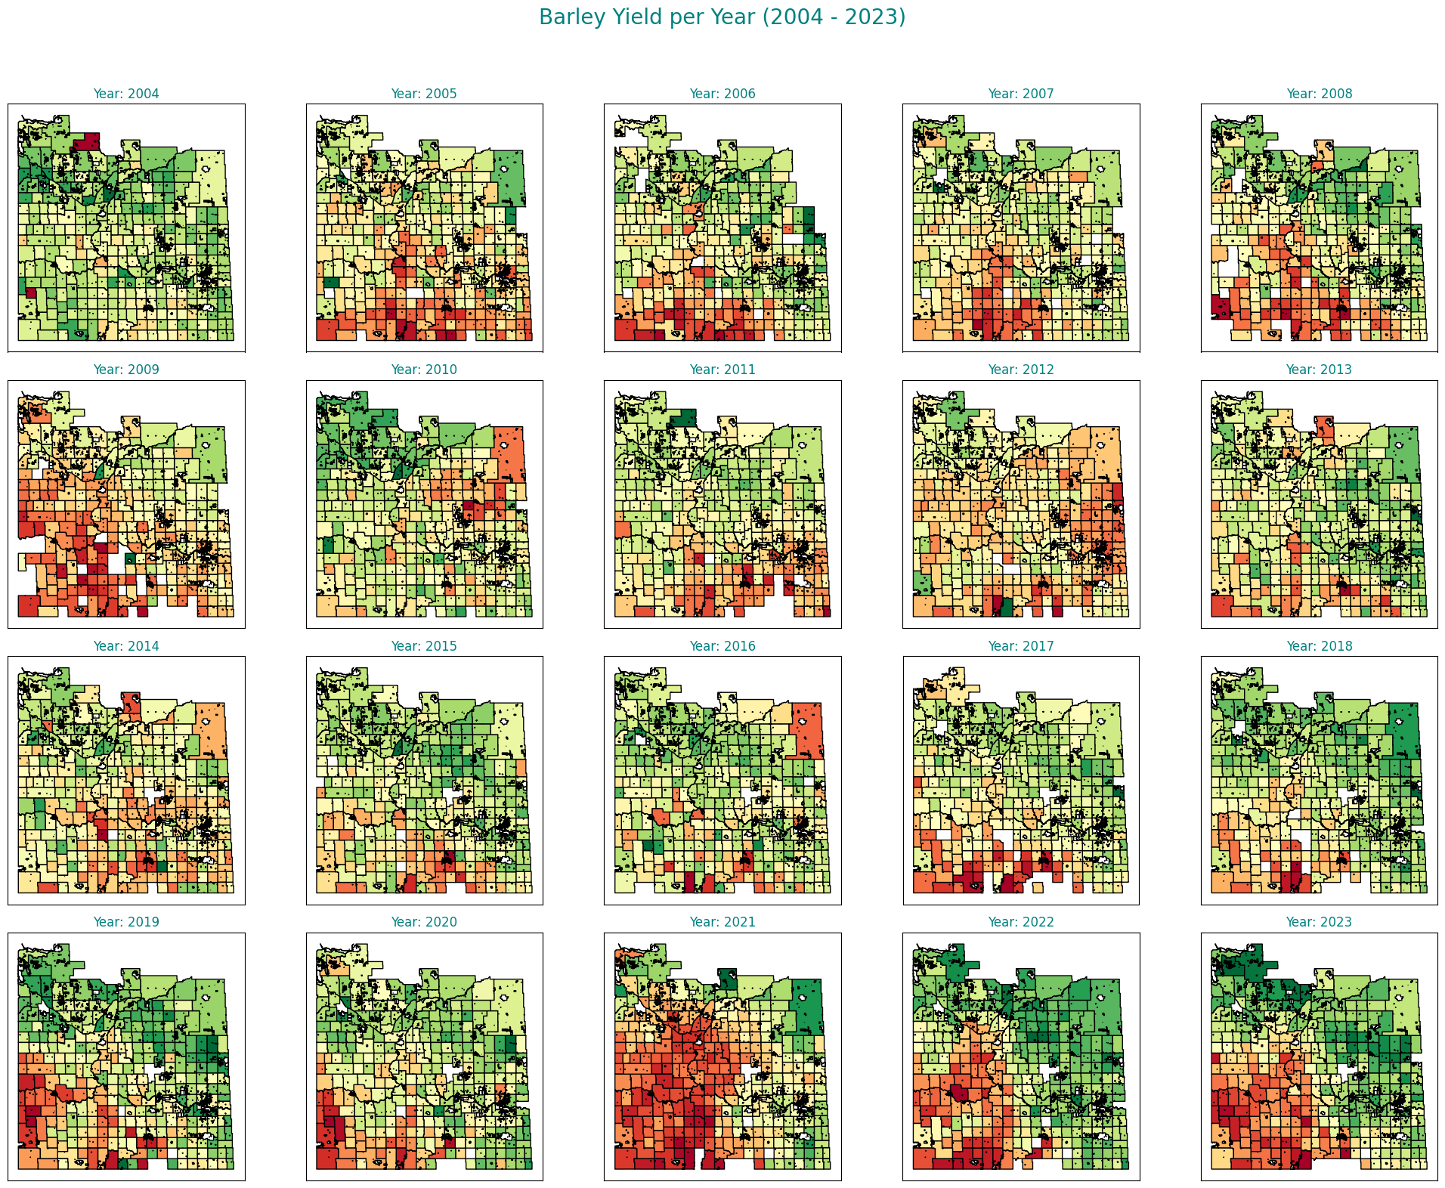

Slide 6
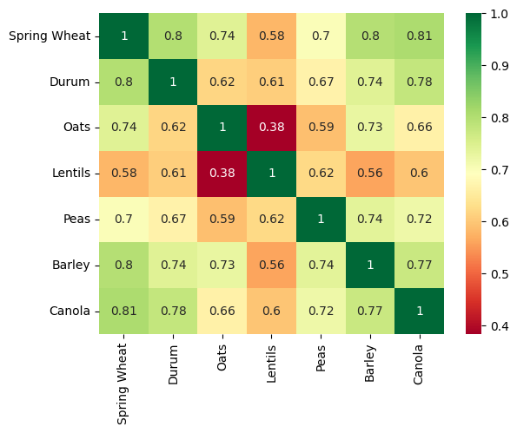
Correlation Analysis

Slide 7
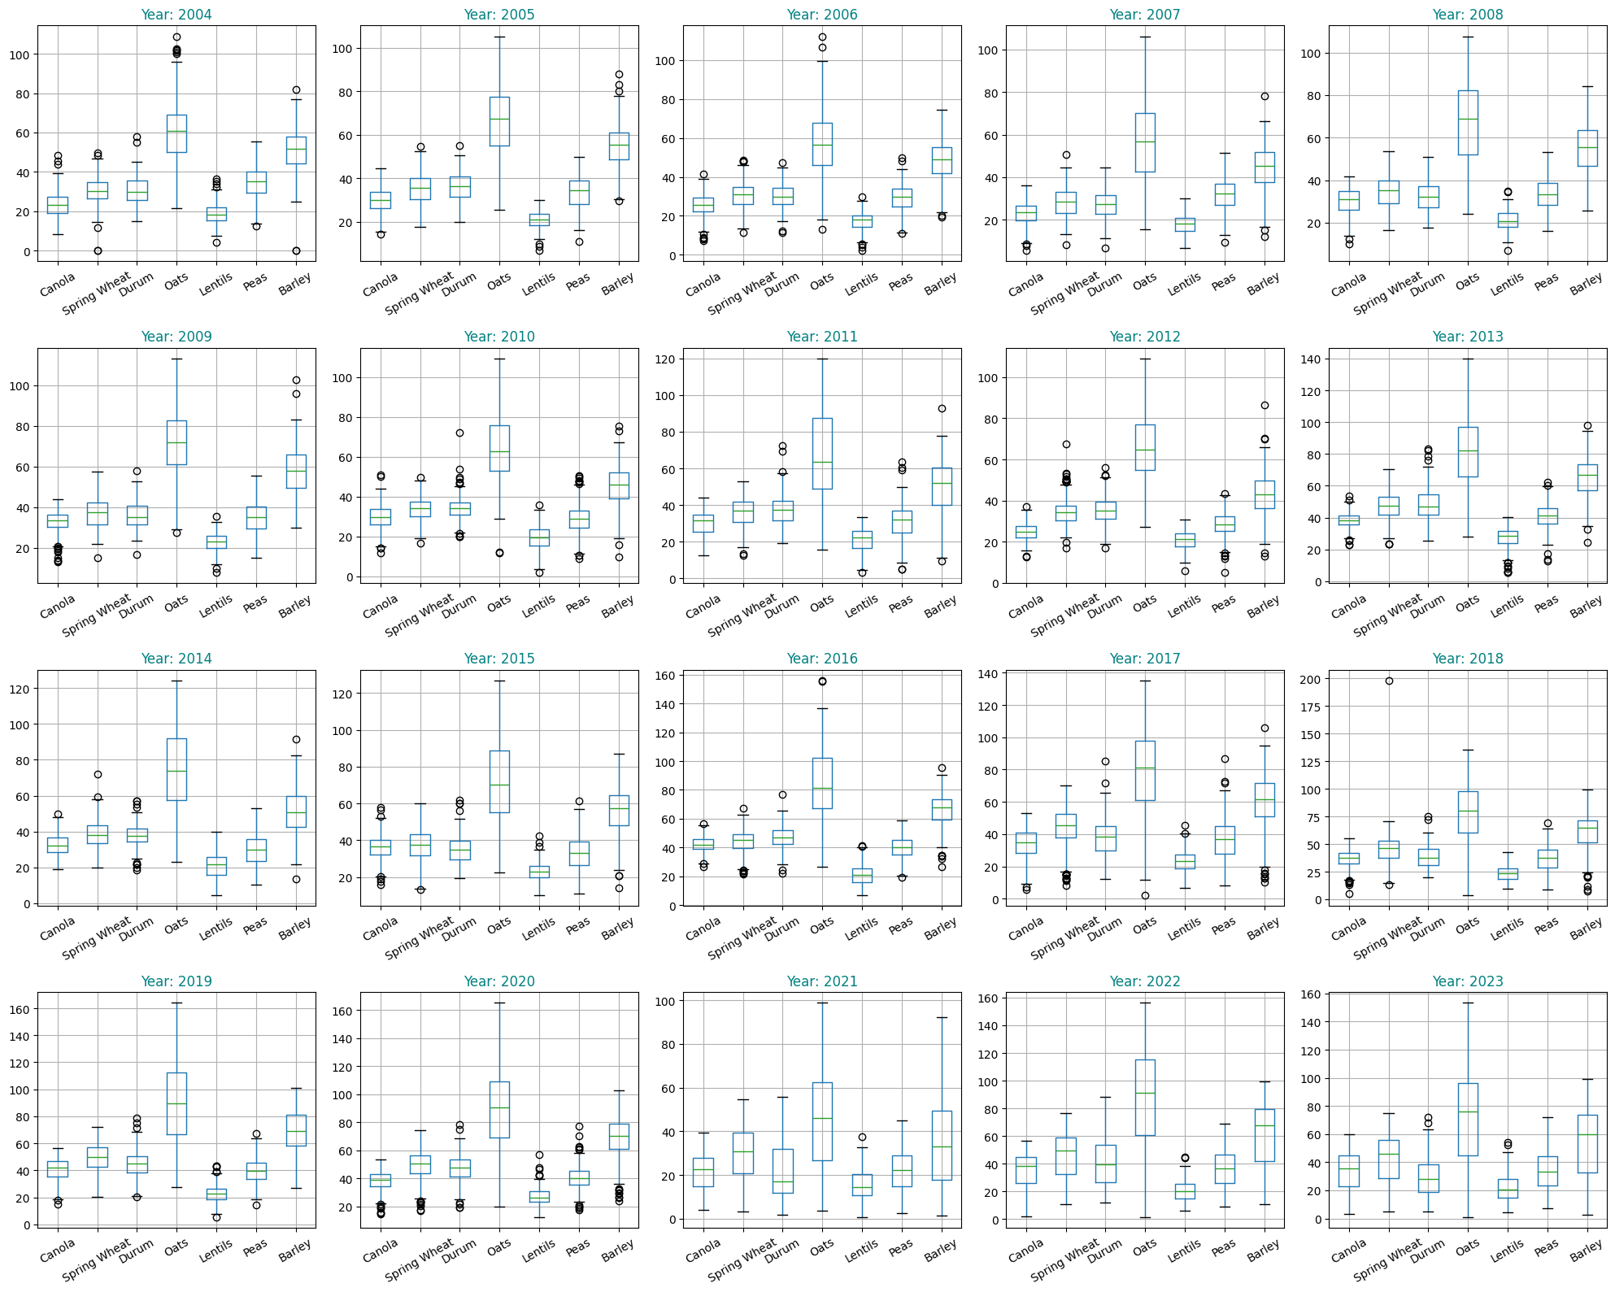
Before Outlier Treatment

Slide 8
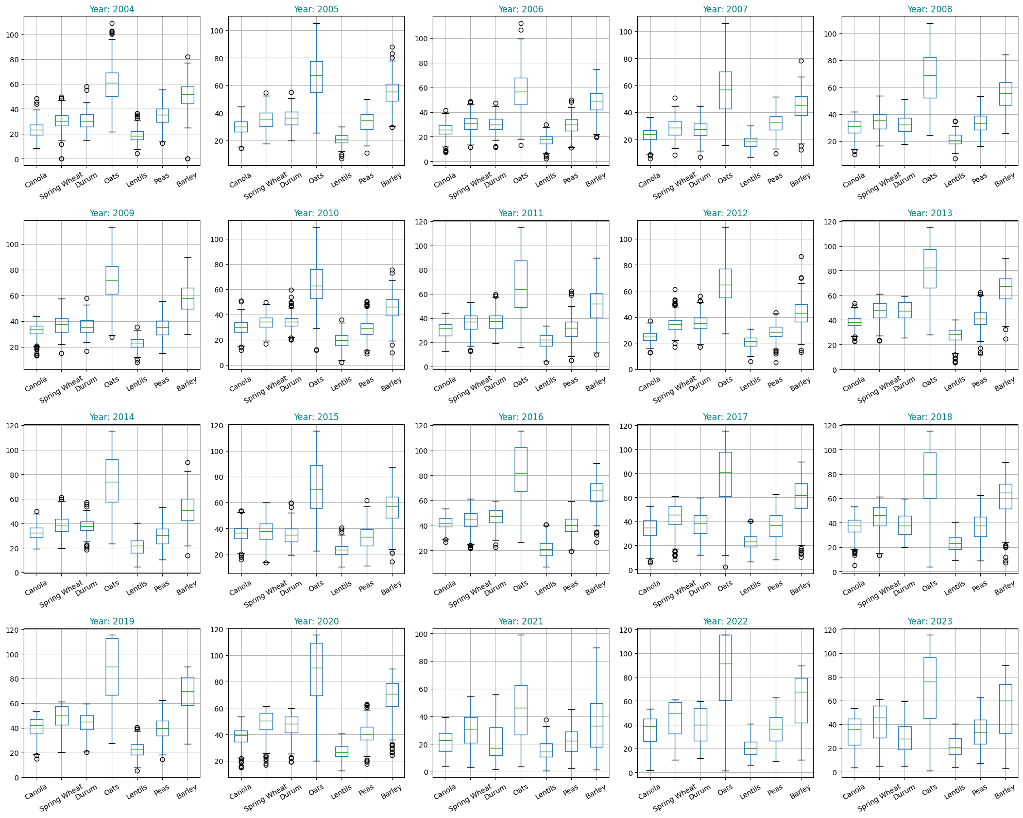
After Outlier Treatment

Slide 9
Clustering Analysis

Slide 10
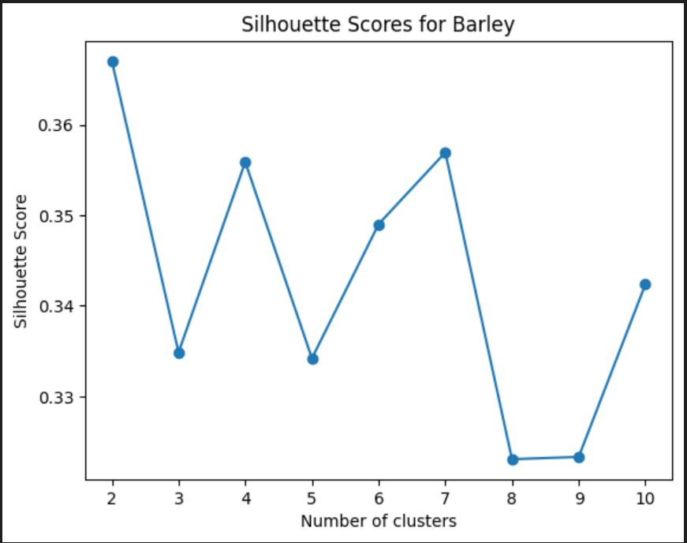

Slide 11
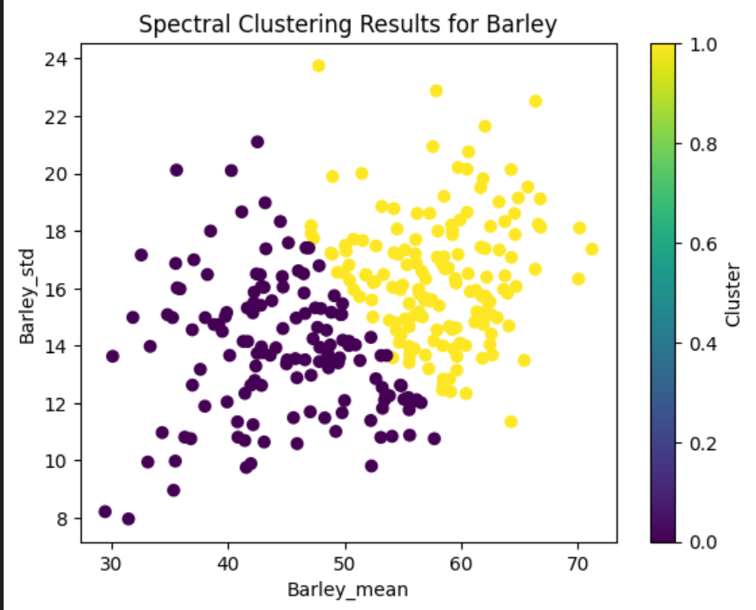

Slide 12
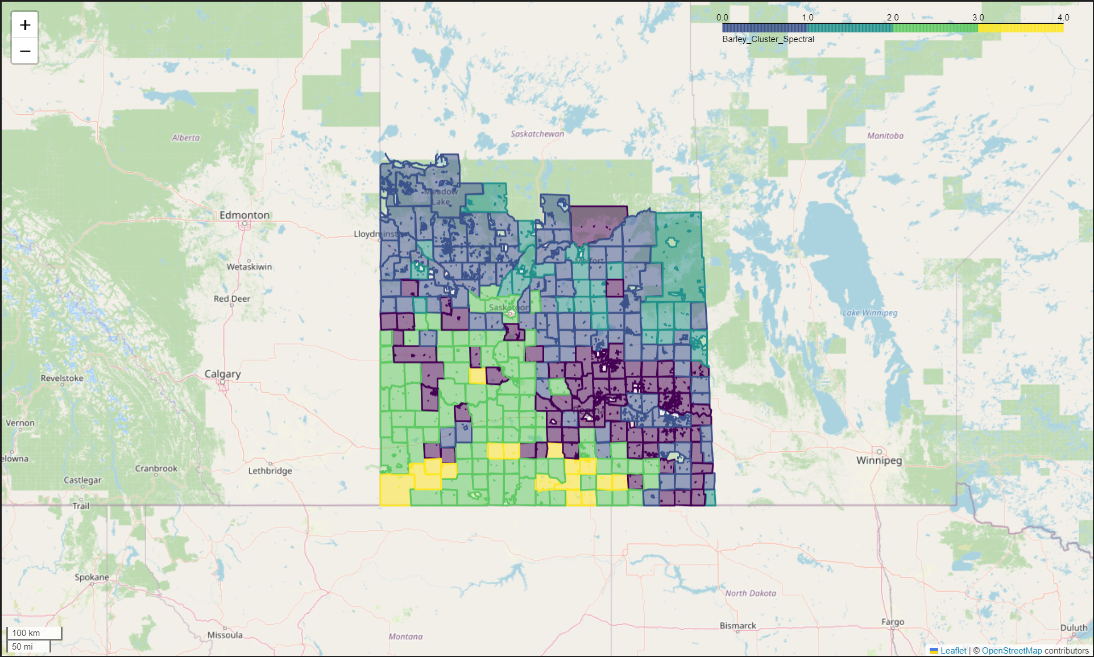

Slide 13
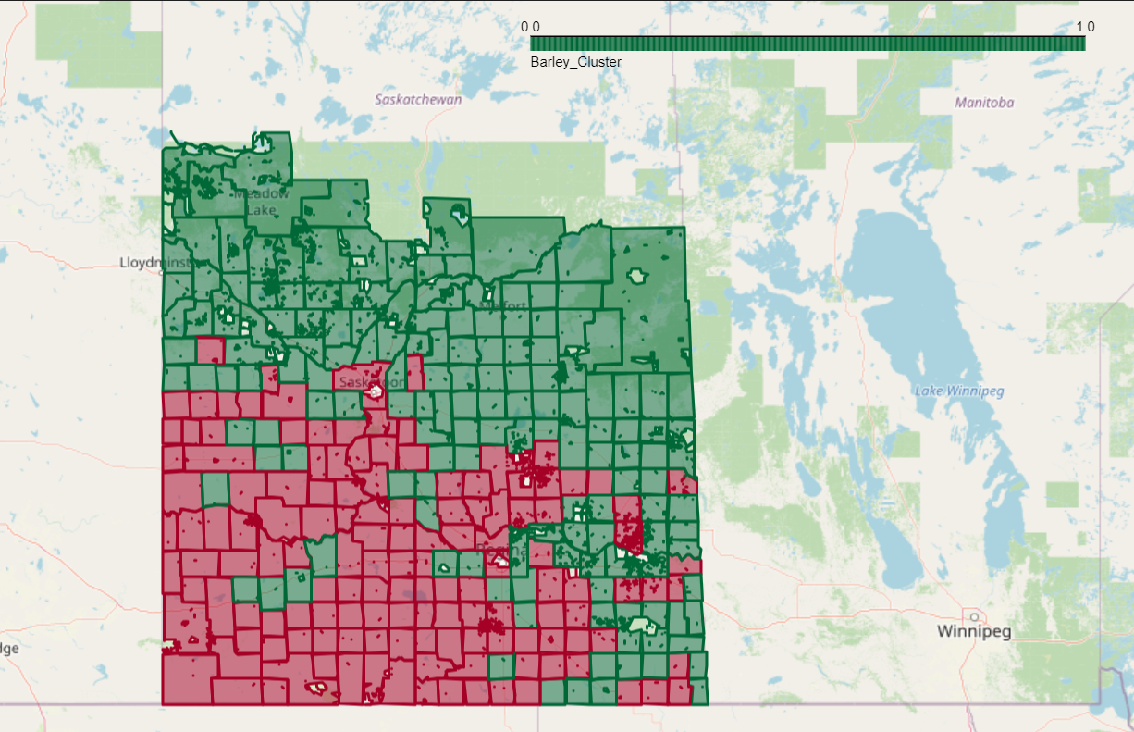

Slide 14
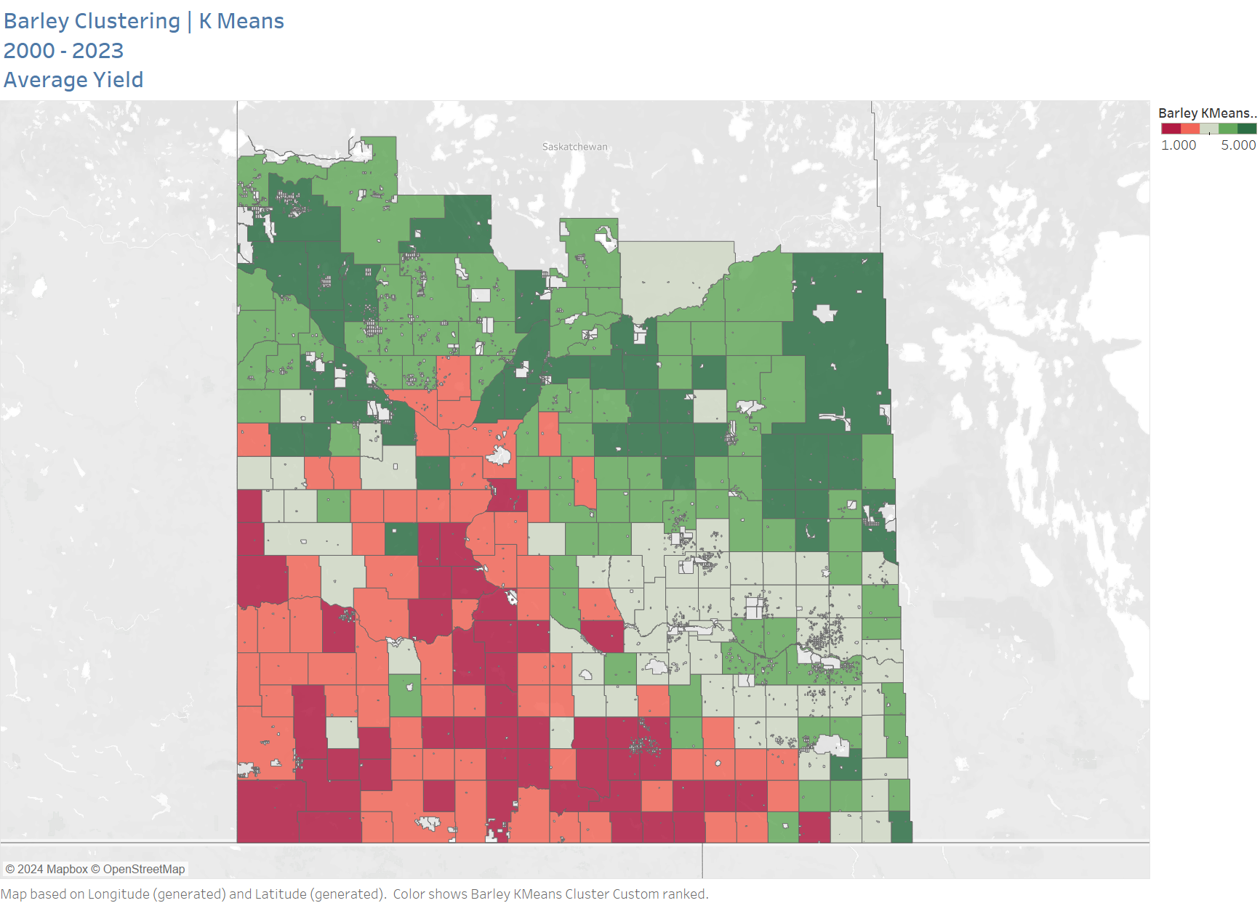

Slide 15
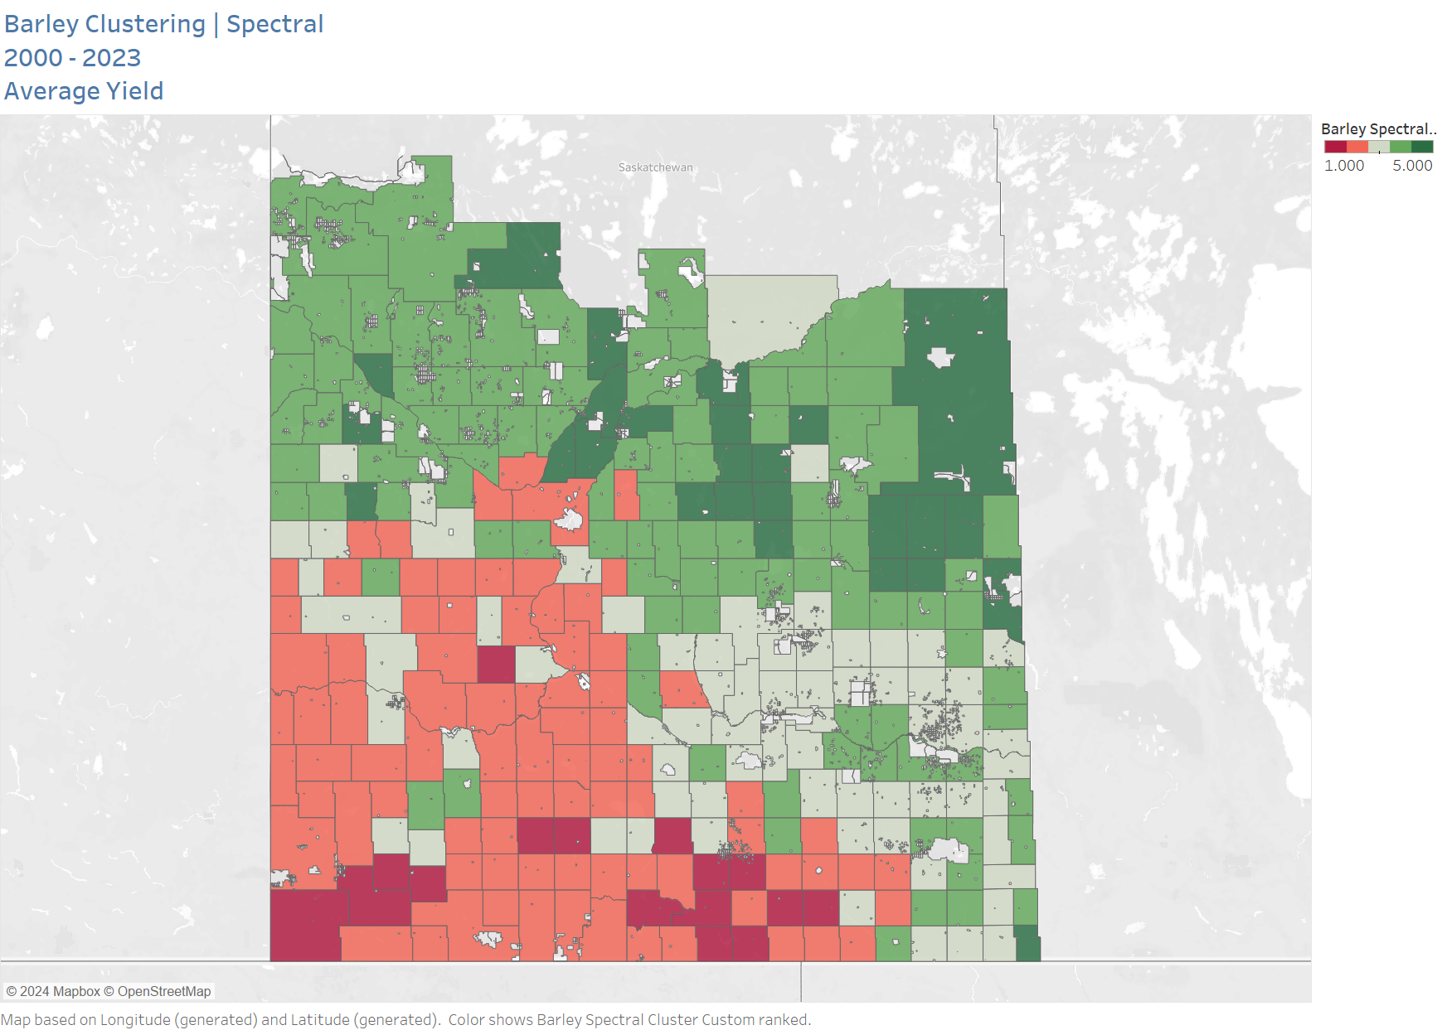

Slide 16
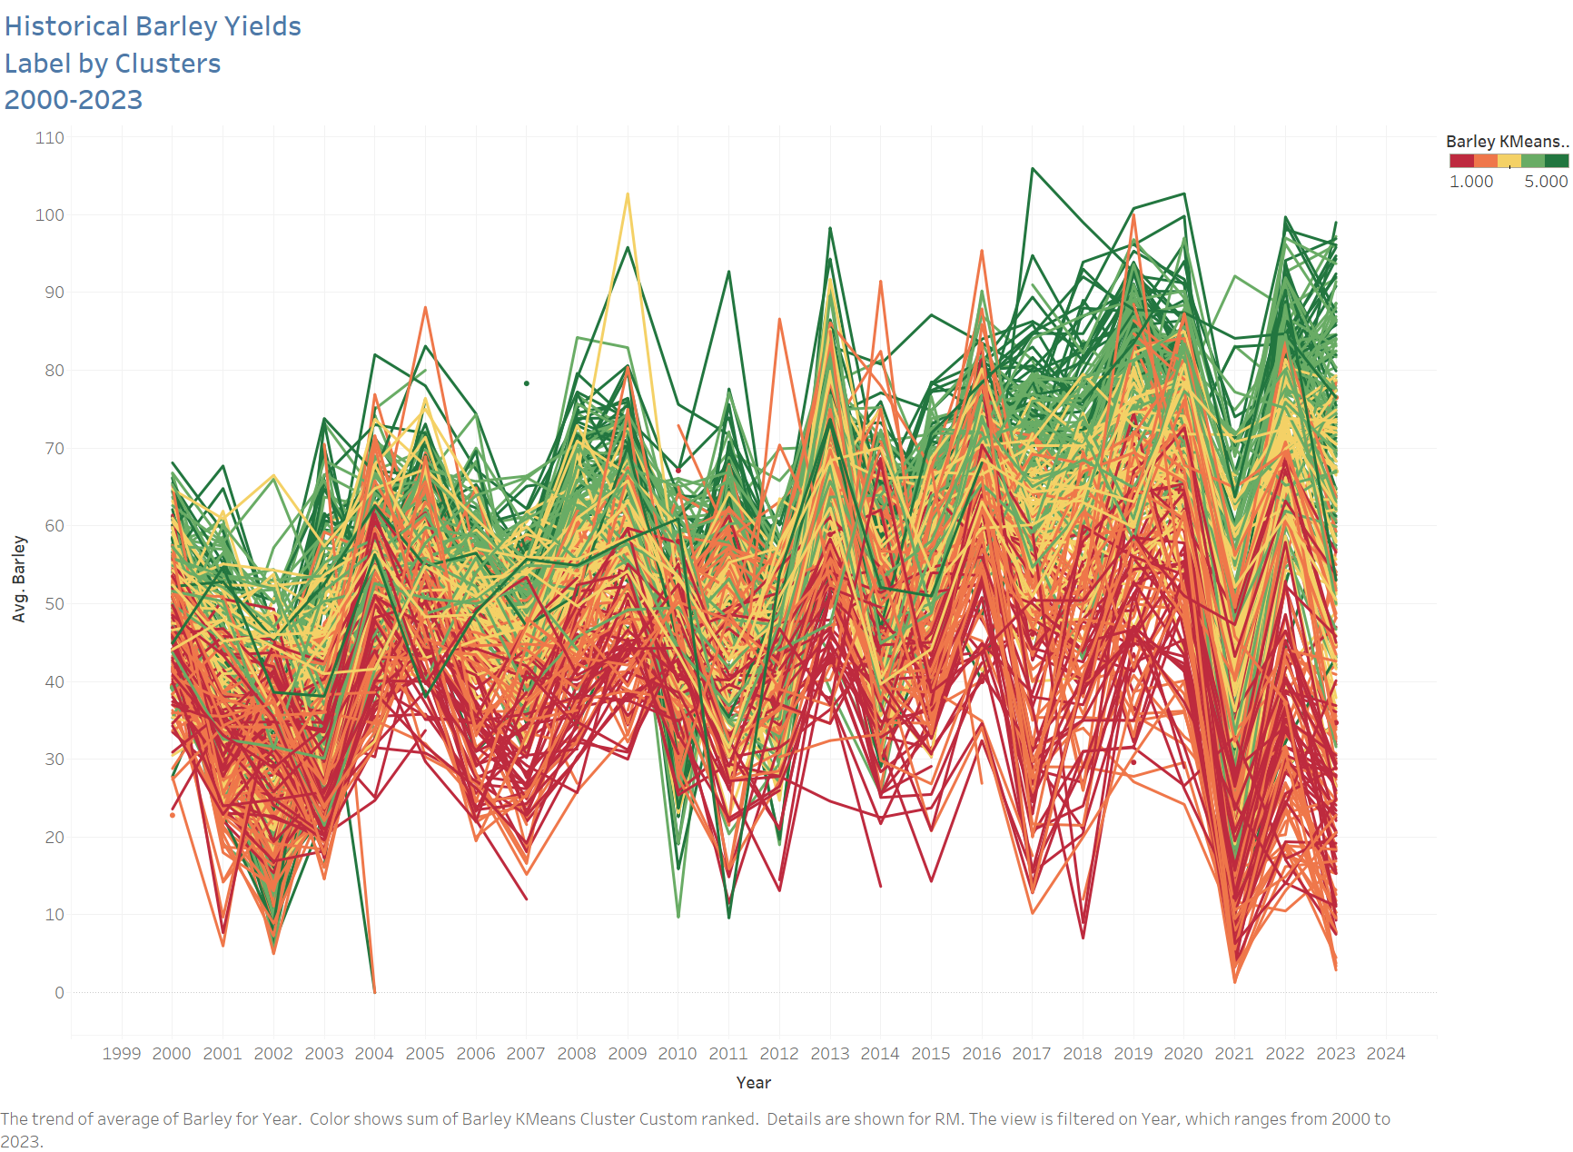

Slide 17
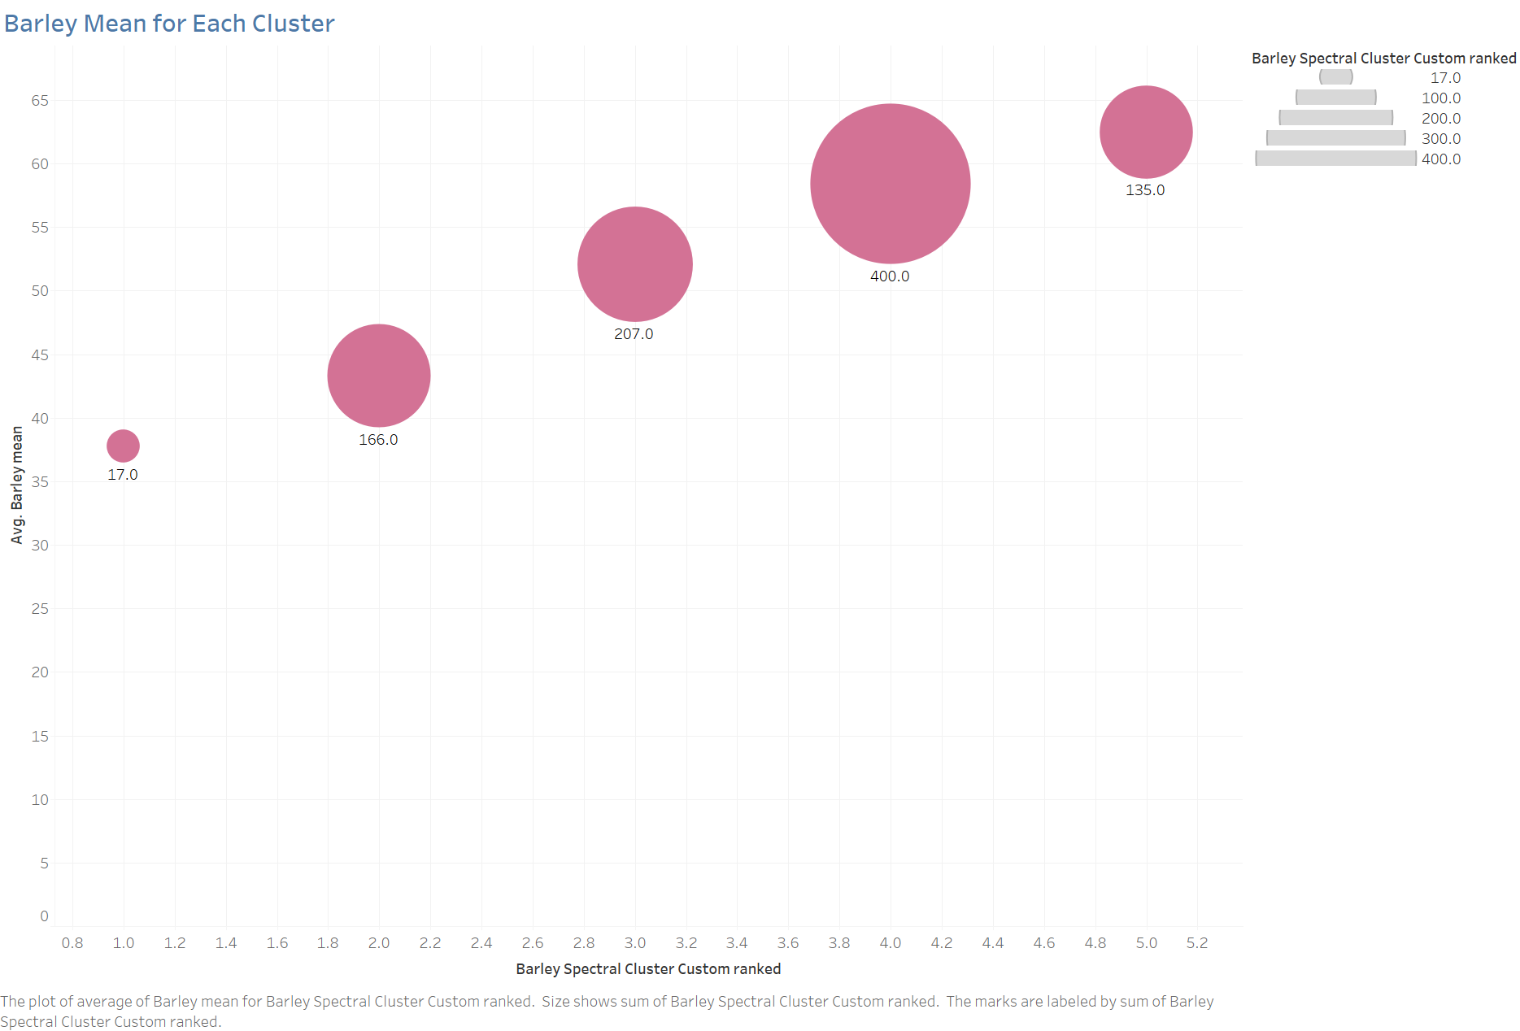

Slide 18
